Slide 1
Predicting the well being score of participants
Using Linear Rregression Modelling

Slide 2
Introduction
This analysis aims to predict the well-being score of participants based on their screen time using statistical and data science techniques.
We will apply data exploration, visualization, and linear regression modeling to uncover the relationship between screen time (e.g., computer, video games, smartphones, TV) and well-being.

Slide 3
Objectives
Explore the dataset to understand the relationships between screen time and well-being scores.
Visualize data to identify trends, outliers, and patterns.
Build a linear regression model to predict well-being scores based on screen time variables.
Evaluate model performance using metrics such as Mean Squared Error (MSE) and R-Squared.
Interpret the results and draw conclusions regarding the impact of screen time on well-being.

Slide 4
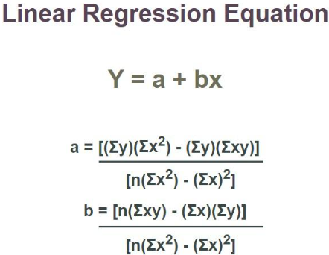
Linear Regression
Linear Regression is a simple and commonly used method to model the relationship between a dependent variable (outcome) and one or more independent variables (predictors). The objective is to find the linear equation that best describes how the dependent variable changes as the independent variables change.

Slide 5
where,
x is Independent Variable, Plotted along X-axis
y is Dependent Variable, Plotted along Y-axis
The slope of the regression line is “b”, and the intercept value of regression line is “a”(the value of y when x = 0).
Least square method is the most common method used to fit a regression line, in the X-Y graph. In this process we determines the line of best fit by reducing the sum of the squares of the vertical deviations from each data point to the line.
With the regression line, which is the approximately close to all the points scattered around the graph, we can evaluate the value of our response variable

Slide 6
Datasets Overview
Dataset 1: Demographic information of 120,000 adolescent respondents.
Dataset 2: Daily digital screen time for approximately 113,000 respondents, including:
C_we: Computer usage on weekends.
G_we: Video game usage on weekends.
S_we: Smartphone usage on weekends.
T_we: TV usage on weekends.
Dataset 3: Self-reported well-being indicators for 102,580 respondents, including:
Optm: Feeling optimistic about the future (target variable for prediction).

Slide 7
Descriptive analysis
Correlation Matrix Heatmap
A correlation heatmap is a graphical representation of the correlation matrix. It uses color gradients to visualize the strength and direction of the relationship (correlation) between multiple variables in a dataset. The heatmap helps quickly identify which pairs of variables are highly correlated and whether their correlation is positive or negative.
Below is a small portion of correlation heatmap which presents the relationship between two variables.

Slide 8
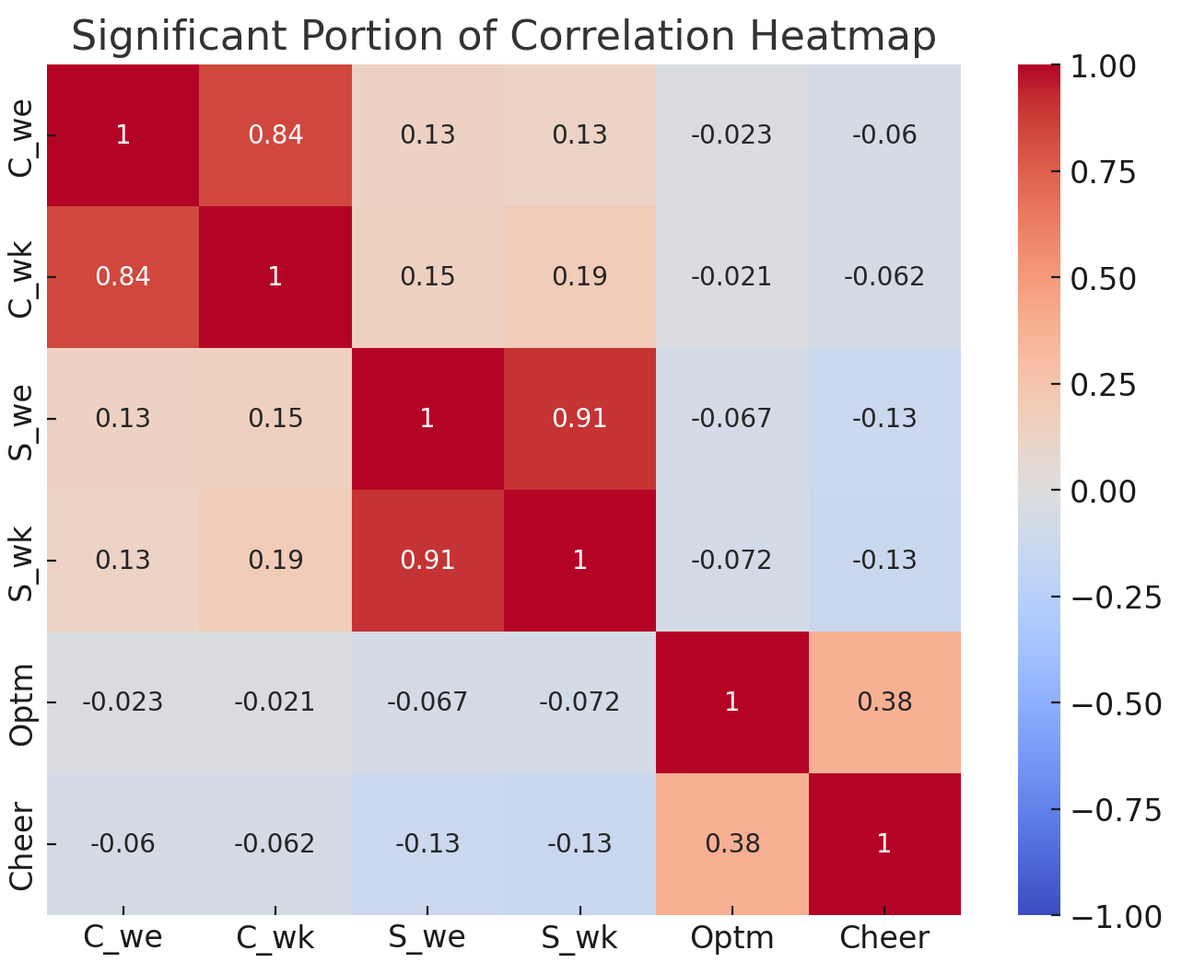

Slide 9
Observations:
C_we and C_wk (computer usage on weekends and weekdays) show a strong positive correlation (0.84), meaning adolescents who spend more time on computers on weekends also tend to do so on weekdays.
S_we and S_wk (smartphone usage) have a similarly strong positive correlation (0.91).
Weak negative correlations exist between screen time (especially smartphone usage) and well-being indicators like optimism and cheerfulness.
The negative correlations seen tell us that screentime could be affecting wellbeing in a negative way.

Slide 10

Using linear regression to predict well being.
Exploratory Data Analysis (EDA) helps identify patterns in the data:
Summary statistics of screen time variables and well-being scores.
Checking for missing values and handling them appropriately.
Identifying outliers in the data through visualizations.

Slide 11
Explanation of steps.
Calculate Total Screen Time:
Total screen time is calculated by summing the screen time spent on weekdays and weekends for computers, video games, smartphones, and TV.
Scatter Plot:
The scatter plot visualizes the relationship between total screen time and the combined well-being score. This will show if there’s a downward trend, indicating a negative correlation.
Prepare Data for Linear Regression:
X: The independent variable is the total screen time.
y: The dependent variable is the combined well-being score.
Fit the Linear Regression Model:
The linear regression model is created using LinearRegression() from sklearn. The model is trained on 80% of the data and evaluated on the remaining 20%.

Slide 12
Evaluate the Model:
Mean Squared Error (MSE): Measures how well the model predicts the well-being score. A lower MSE indicates better predictions.
R-Squared (R²): Represents the proportion of the variance in well-being scores that can be explained by total screen time. A low R-squared suggests that other factors besides screen time might affect well-being.
Plot the Regression Line:
The regression line is plotted on the scatter plot, showing the overall trend of how total screen time affects well-being.
Print Model Coefficients:
The intercept represents the baseline well-being score when screen time is zero.
The coefficient for screen time tells us how much the well-being score changes for each additional hour spent on screens. A negative coefficient would indicate that increased screen time is associated with lower well-being.

Slide 13
Expected Results
Scatter Plot:
The scatter plot should show a negative trend if there’s a negative relationship between total screen time and well-being scores. This can be reinforced by the linear regression line on the plot.

Slide 14
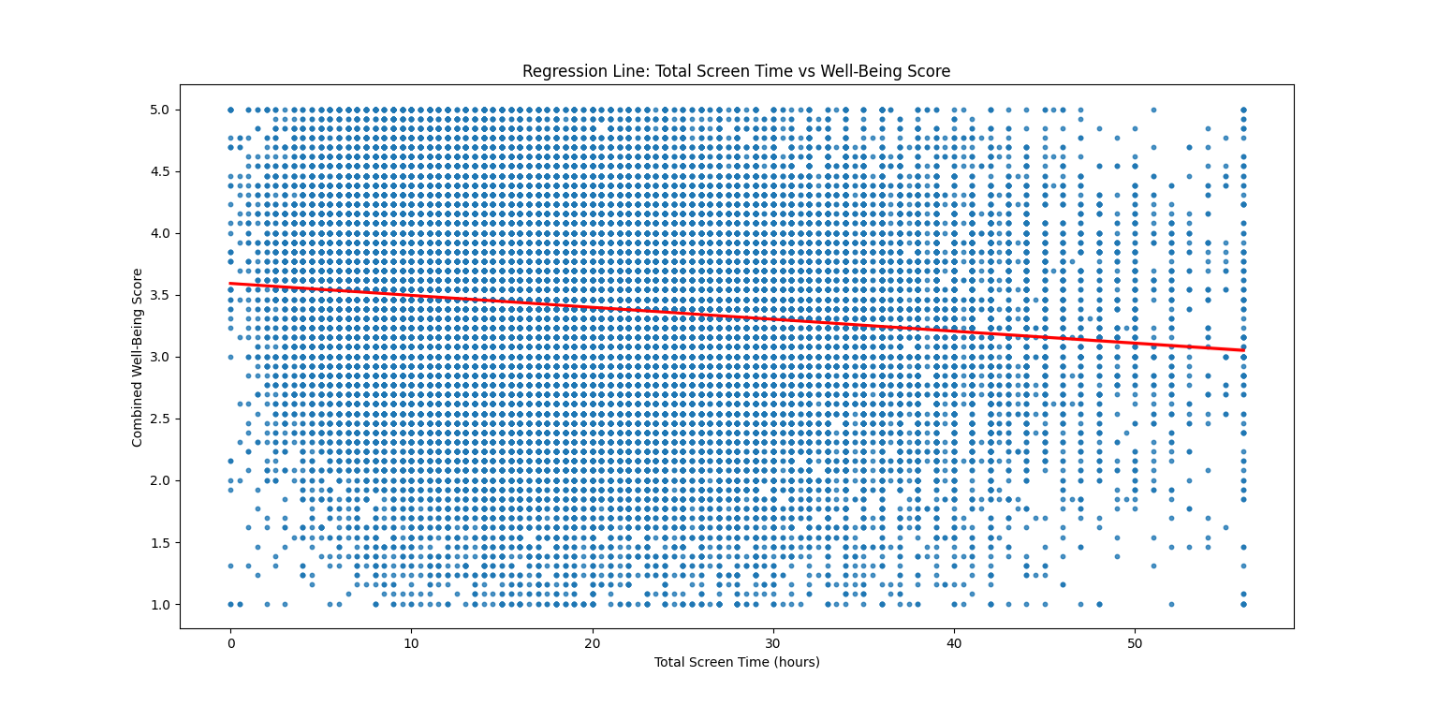

Slide 15
Outcomes
Model Coefficients:
If the coefficient for screen time is negative, it indicates that increased screen time leads to a decrease in well-being.
We obtained:
Intercept (β₀): 3.5898 : This means assuming no screen time is used. A score of 3.59 suggests a neutral to slightly positive well-being score
Coeffiecient of Total Screen Time= -0.0096:
For every 1 additional hour spent on screens per week, the predicted well-being score decreases by 0.0096 units.Over time, as total screen time increases significantly, this negative effect on well-being may become more pronounced.

Slide 16
Results
Mean Squared Error (MSE): 0.4899
MSE measures the average squared difference between the actual well-being scores and the predicted well-being scores.
An MSE of 0.4899 means that, on average, the model's predictions are off by about 0.49 units from the actual well-being scores.
Interpretation: Although the MSE is relatively low, it should be compared against other models to evaluate whether this is a good fit for the data.
R-Squared (R²): 0.0159
R² indicates how much of the variance in the well-being scores is explained by the total screen time.
An R² value of 0.0159 means that only 1.59% of the variation in well-being scores can be explained by screen time alone.
Interpretation: This is a very low R², indicating that screen time is not a strong predictor of well-being. Other factors not included in this model likely play a larger role in determining well-being.

Slide 17
Key Insights
Low Predictive Power:
The low R-squared (0.0159) indicates that screen time alone does not strongly explain the variation in well-being scores. This suggests that other factors (e.g., mental health, social interactions, sleep quality) are likely much more important in determining well-being.
Negative Relationship with Screen Time:
The negative coefficient for screen time (-0.0096) suggests that, on average, more screen time is associated with slightly lower well-being.
Although the effect is small, it indicates that increased screen time can have a negative impact on well-being over time.

Slide 18
Small Effect Size:
While the negative relationship exists, the small effect size suggests that screen time alone might not significantly affect well-being, or its effect might be diluted when other variables (e.g., mental health, social relationships) are considered.

Slide 19
Implications
Based on our dataset, the linear regression test shows that screen time has a very small negative impact on optimism, but the effect is negligible. With an R-squared of only 0.0159, the model explains very little variance in optimism (about 1.59%). This suggests that screen time alone is not a significant predictor of well-being, and other factors likely play a more important role in influencing optimism.

Slide 20
Conclusion
While the model shows a negative relationship between screen time and well-being, the low R-squared value suggests that other factors are likely more important in determining well-being.

Slide 21
Other factors that could significantly influence well-being, particularly optimism, include:
Social Relationships: Quality of interactions with family, friends, and peers.
Mental Health: Anxiety, depression, and overall emotional well-being.
Physical Activity: Exercise and fitness levels are known to boost mood and well-being.
Sleep Quality: Poor sleep can negatively affect mental health and optimism.

Slide 22
Thankyou

